Slide 1
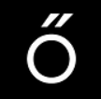
Rating Coffee
Team Members: Cassidy Madison, Ethan Semrad, Ching-Lung Hsu
https://github.com/madisonc27/Team-Dragonfly
May 2022 The Erdos Institute
Data Science Bootcamp

Slide 2
Introduction
Facts: Coffee is one of the world’s most popular beverages. Therefore, it is important to have a further study on coffee recommendation for the coffee lovers around the world.
Targeted Users: An estimated 154 million adults (75%, age ≥ 20 y) of the US population reported drinking coffee. (Loftfield, Erikka, et al., 2016)
Our approaches: We approach this question in two different trials.
Classify the country of origin/ altitude/ bean processing method.
Predicting the overall rating based on other features.
Data Source:
https://www.kaggle.com/datasets/ankurchavda/coffee-beans-reviews-by-coffee-quality-institute
https://www.kaggle.com/datasets/aryansakhala/coffee-recommendation
Notes:
https://www.ncbi.nlm.nih.gov/pmc/articles/PMC4997286/
Loftfield, Erikka, et al. "Coffee drinking is widespread in the United States, but usual intake varies by key demographic and lifestyle factors." The Journal of nutrition 146.9 (2016): 1762-1768.

Slide 3
The First Trial

Slide 4
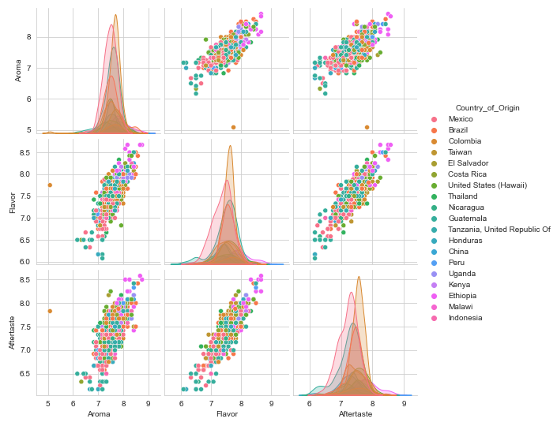
EDA
We removed irrelevant columns and any entry missing review scores or information on the country of origin.
After cleaning, a portion of pairplot exploring the relationships between variables can be seen on the right.
Although certain countries can be separated from others, many of them are highly overlapping each other.

Slide 5
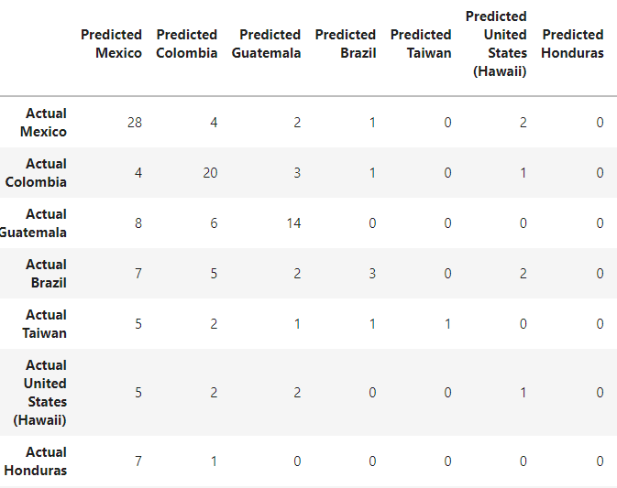
Mode Training
Confusion Matrix for SVM
Applying several supervised learning models to the clean data including
1. K-nearest neighbors
2. Decision Tree
3. Random Forest
4. AdaBoost
5. Support Vector Machine
We use accuracy as a base metric to compare the models. However, the accuracy is around 30 – 35% for all the model described above.

Slide 6
Conclusion
Upon reflection, we think several factors cause the low accuracy of the models.
The correlation between each predictors are pretty high.
The classification models tend to place the samples into the categories with the largest number of samples. Since the data overlaps a lot. This leads to the low accuracy rate.
We conclude that the Coffee Quality Institute ratings do not differ significantly between different countries, growth altitudes, or processing methods.

Slide 7
The Second Trial

Slide 8
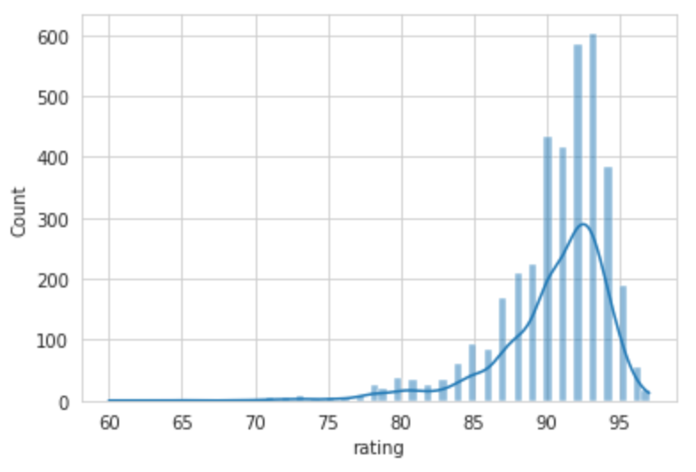
Exploratory Data Analysis
Histogram and Density Plot for Rating
After cleaning, this data contains 4,677 x 21 reviews and we separate the data into training (80%) and test set (20%).
The distribution of rating is slightly left-skewed.

Slide 9
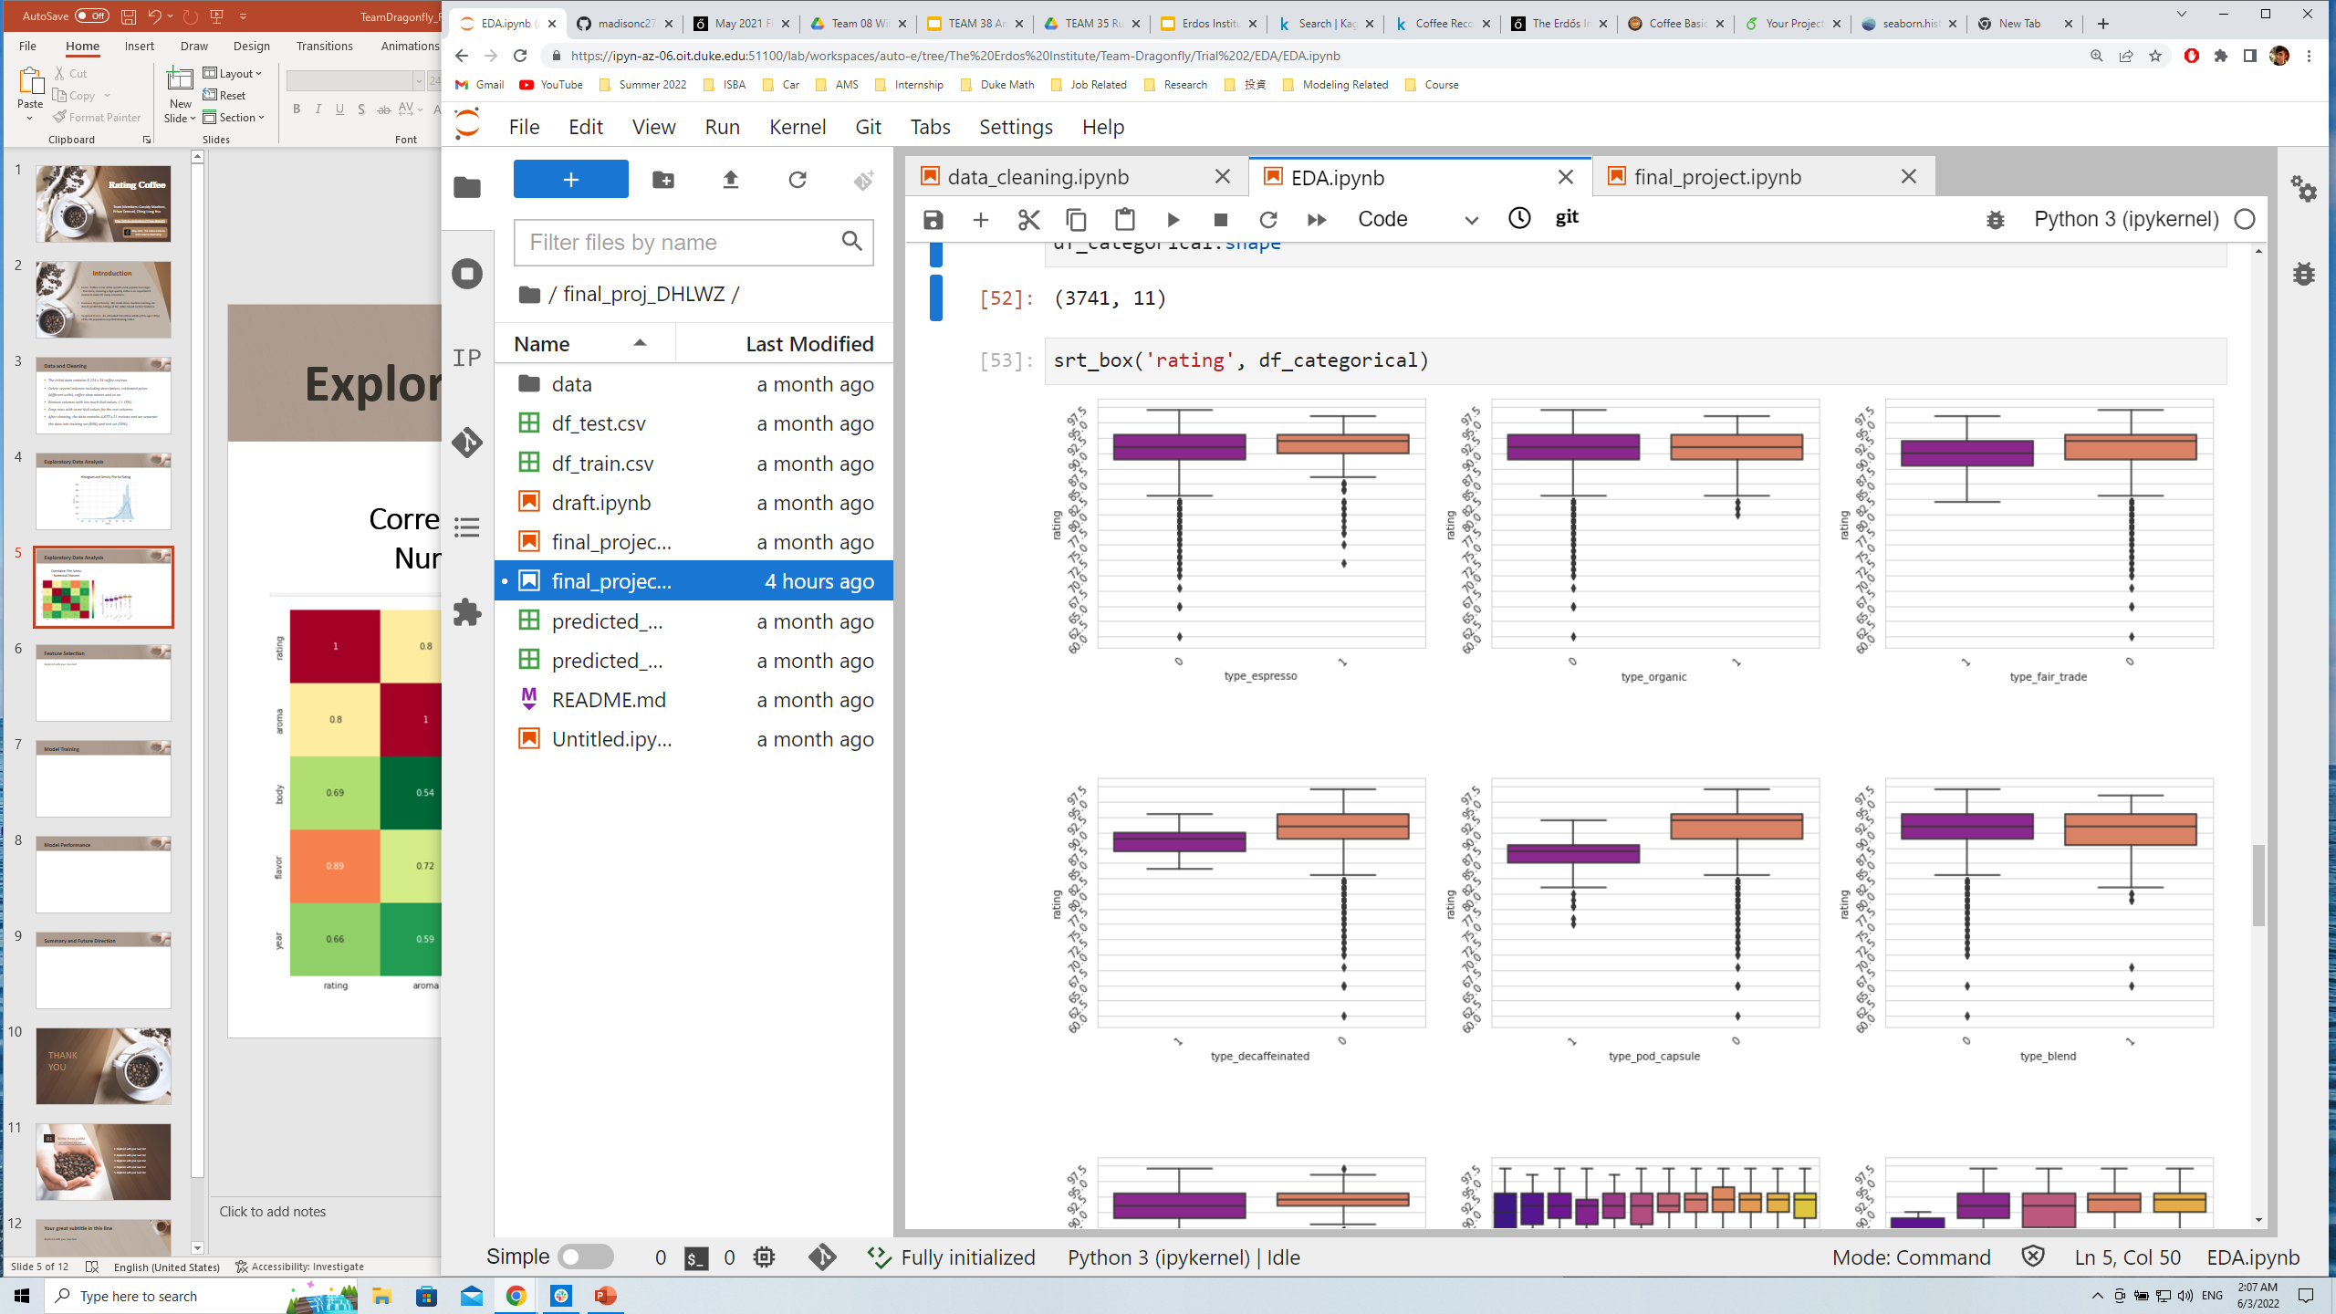
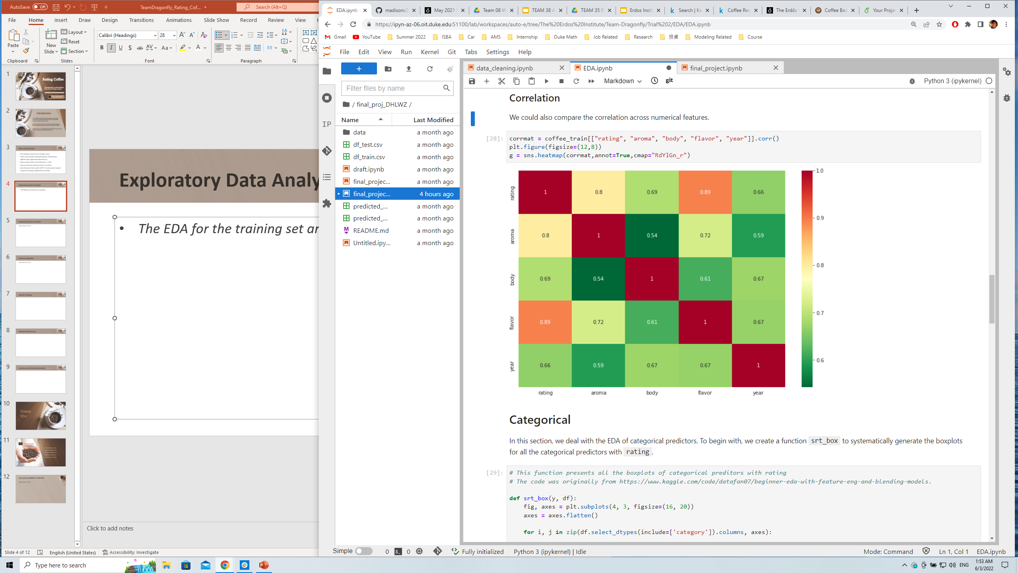
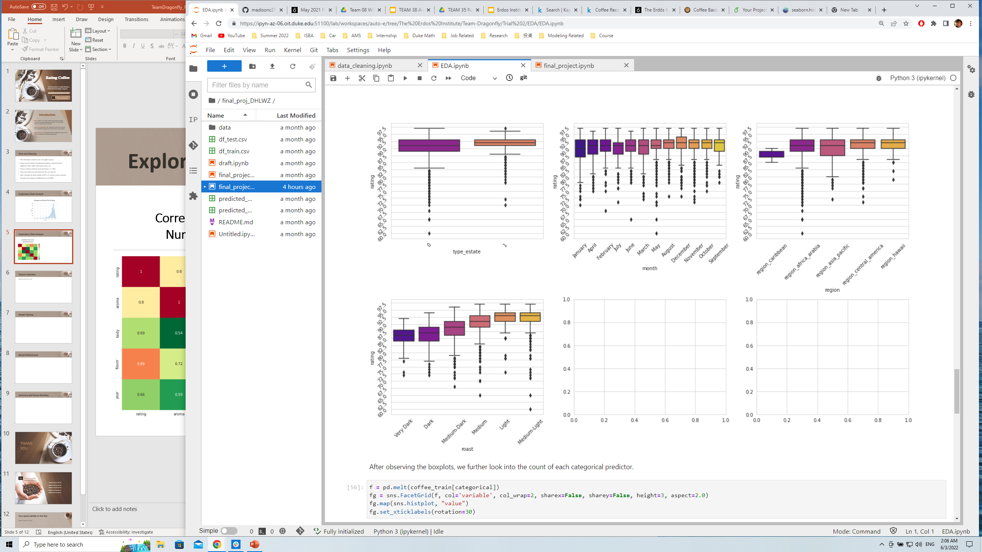
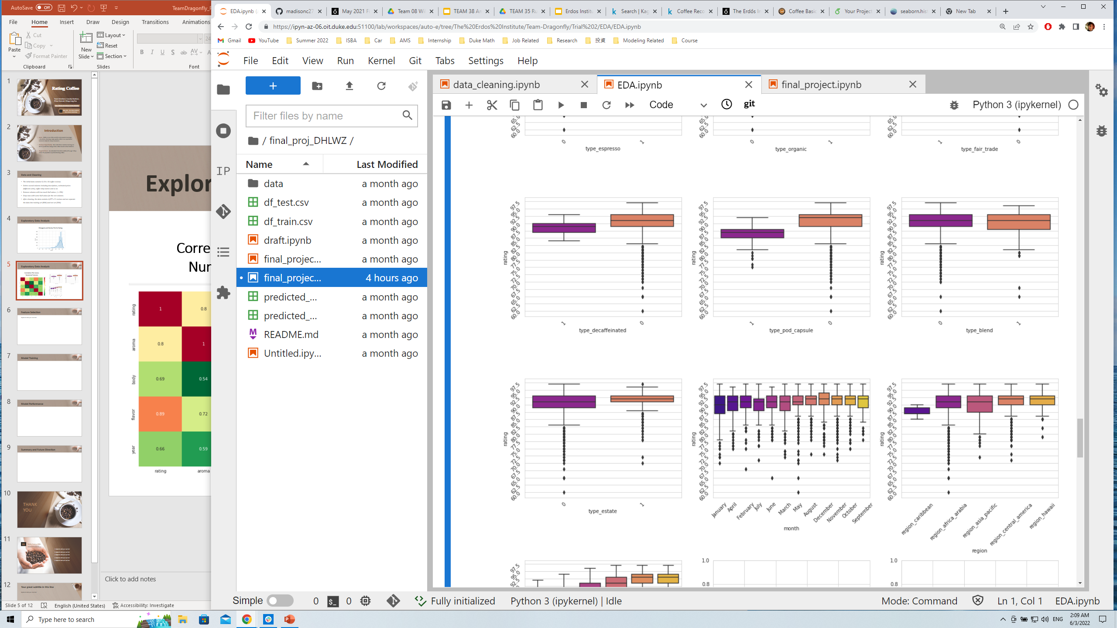
Exploratory Data Analysis
Boxplots for Categorical Features
Correlation across
Numerical Features

Slide 10
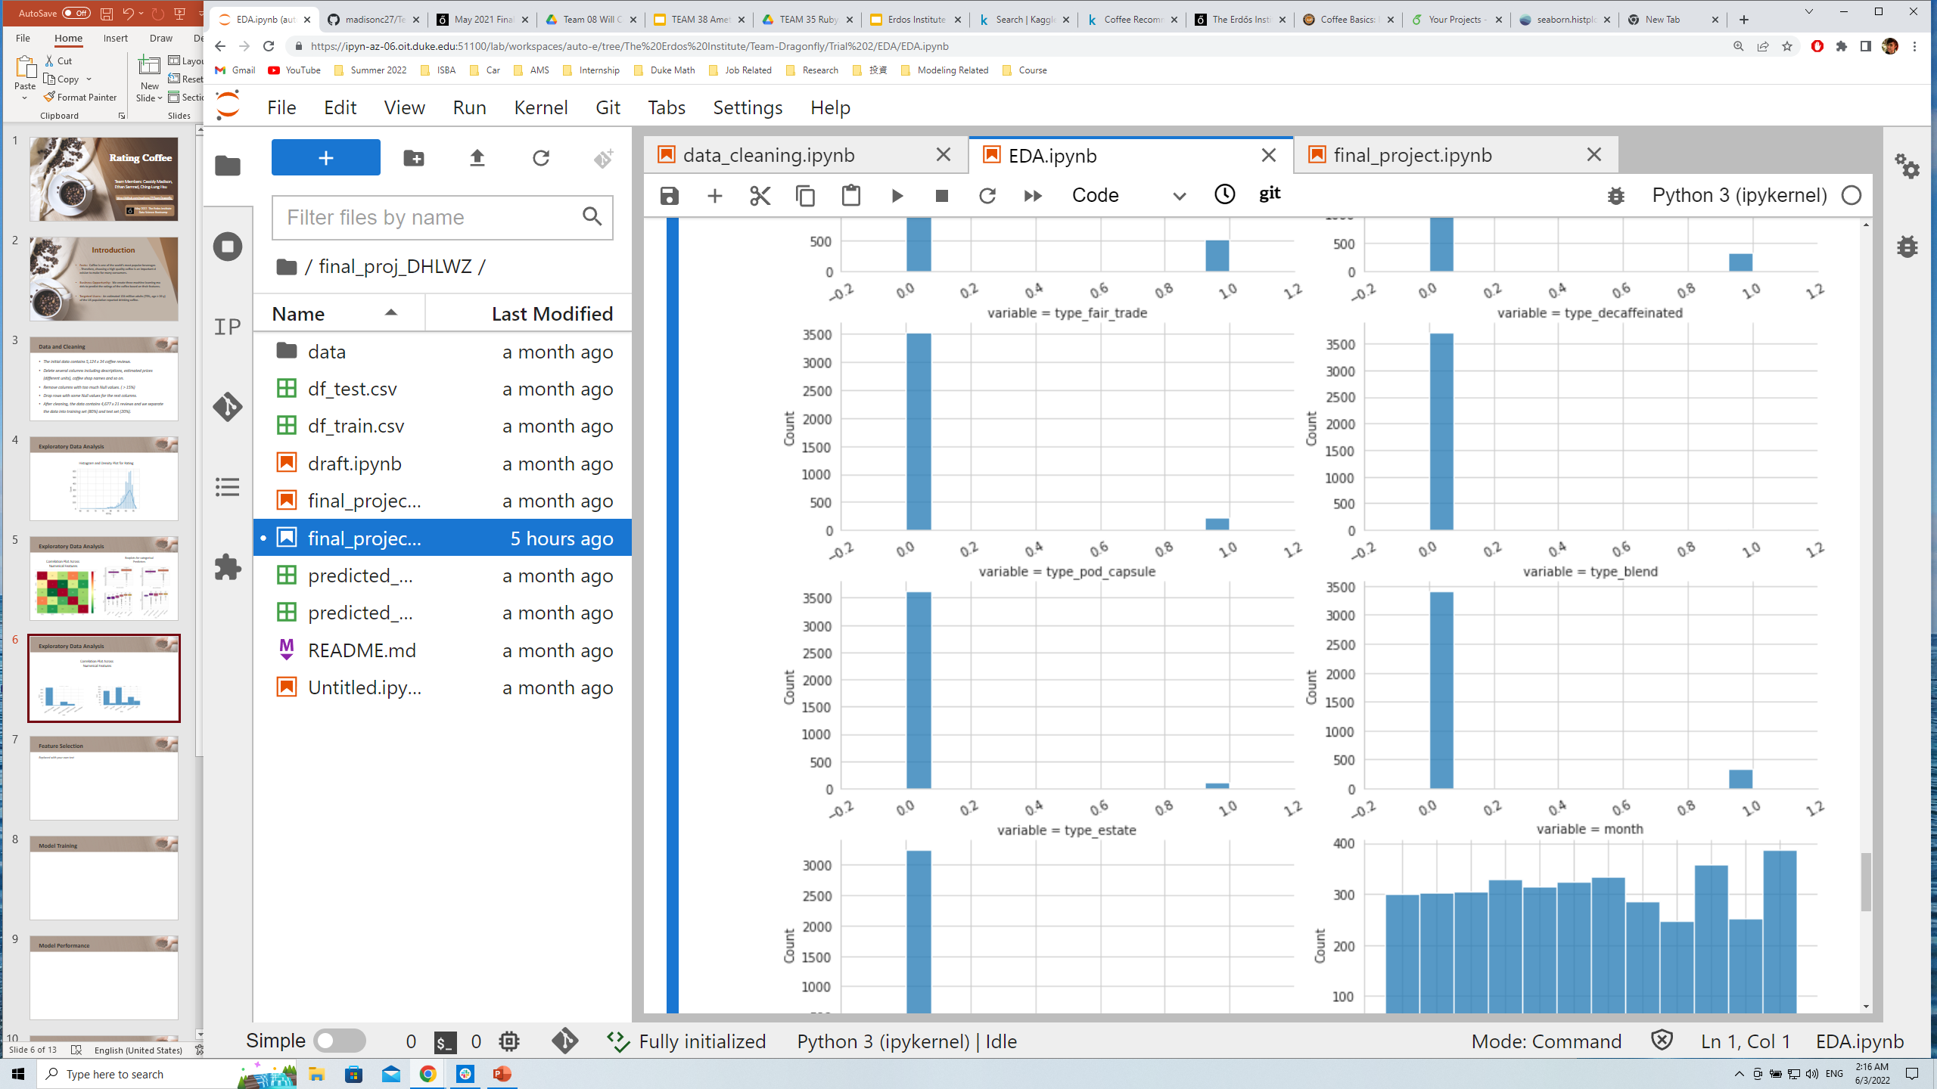
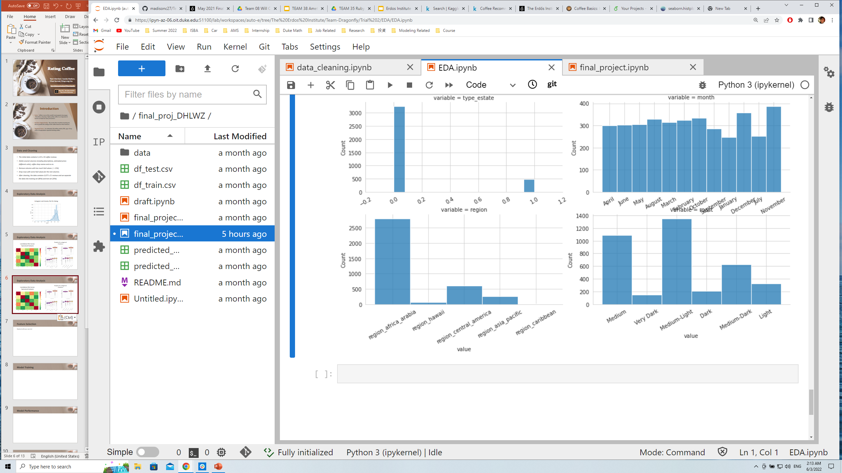
Exploratory Data Analysis
Imbalanced Predictors

Slide 11
Model Training
Since the numerical predictors are still highly correlated, we decided to use only the categorical predictors.
We apply Multiple Linear, Losso, Ridge Regression to our training data.
We create a baseline model that simply making prediction as the mean rating from the training set to compare the performance.
We did not apply a polynomial regression because our predictors consist entirely of 0s and 1s.
At the end, we also include interaction terms with predictors with stronger effect.

Slide 12
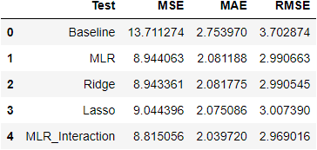
Model Result
The following table summarizes the performance of each model we mentioned earlier.
We applied these models to the test data set and got the mean square error (MSE) and mean absolute error (MAE).

Slide 13
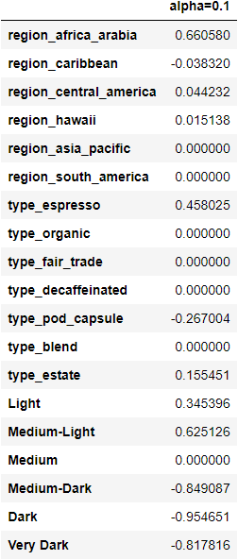
Key Takeaways
Lasso Regression also reveals which features are more important for a higher consumer rating.
Lighter/ Midium-Light roast has more positive effect on the rating while darker roast tends to lower the rating.
Africa/Arabia coffee tended to rate higher, while Caribbean coffees rated slightly lower.
Features like Organic, fair trade, decaffeination, and blends does not affect the rating that much.

Slide 14
Future Directions
Tidy up the format of price data contained in our data and incorporate them into the predictors of our models.
Add some sentiment analysis like natural language processing for the coffee review to extract the features of the comments from the customers.

Slide 15
THANK YOU

